Slide 1

Film Distribution Co Analytics
7/5/2023 12:44:24 PM, Milan (Italy)
Zoya Matsiy

Slide 2
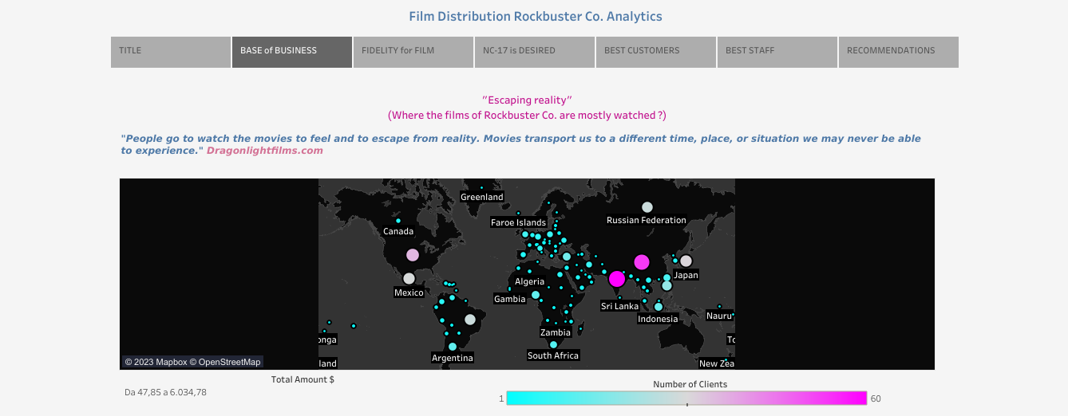

Slide 3
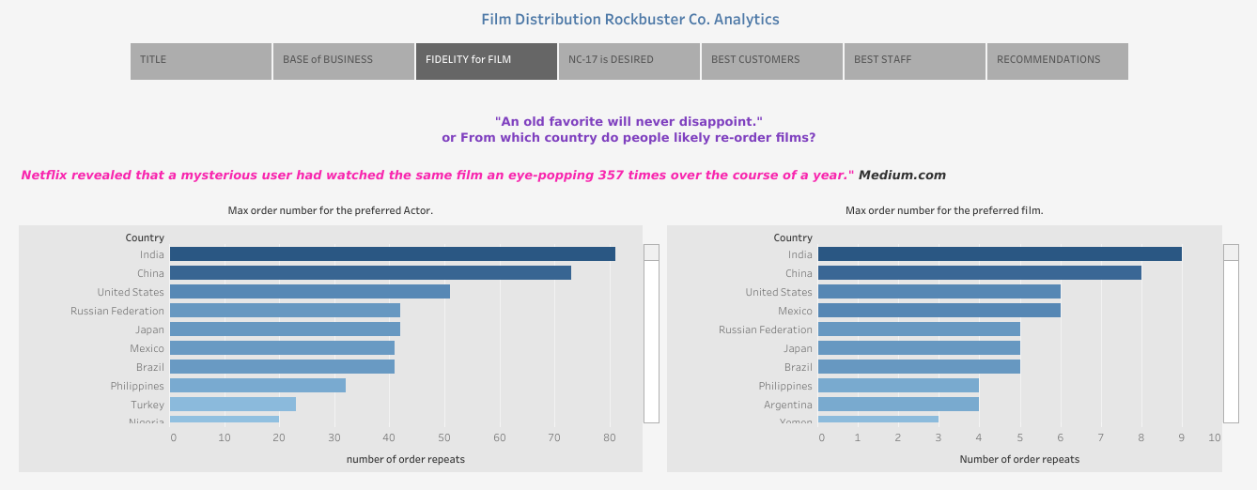

Slide 4
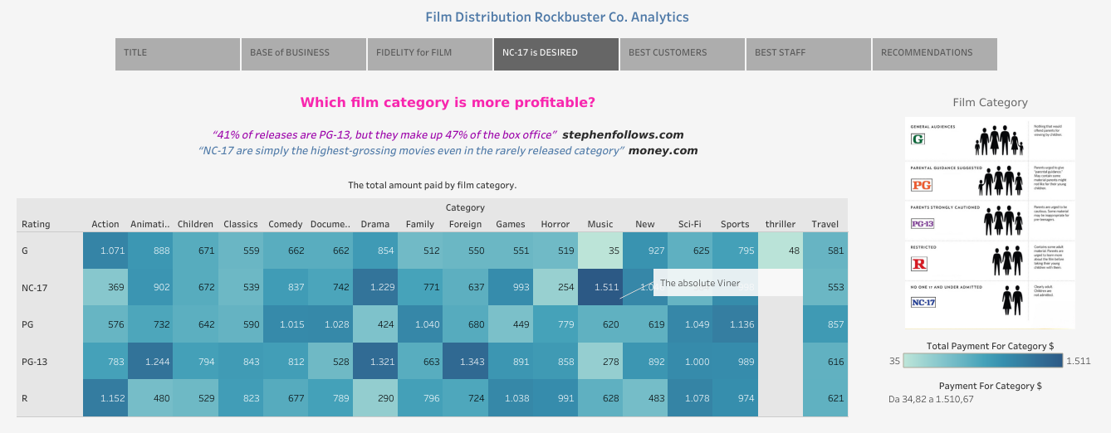

Slide 5
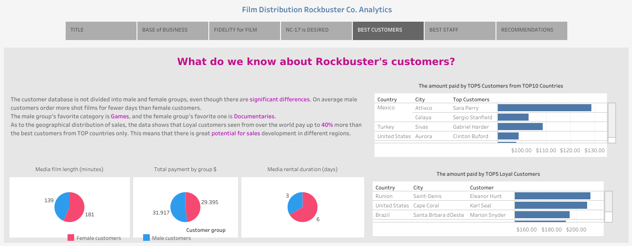

Slide 6
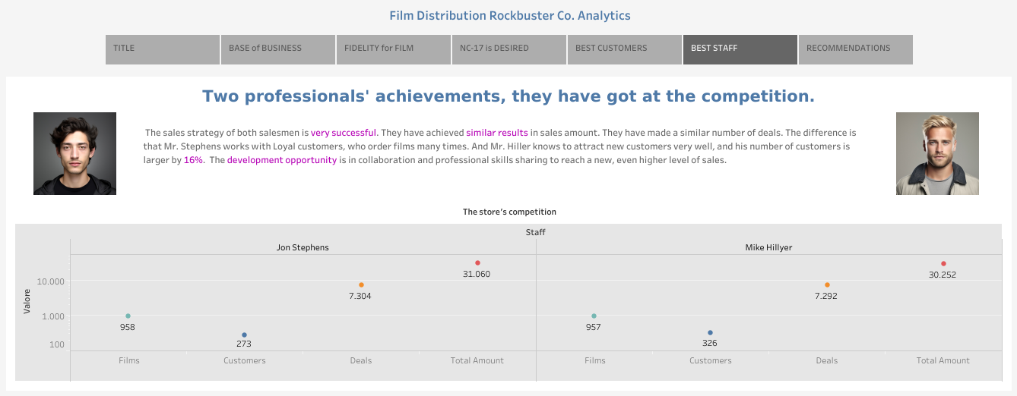

Slide 7
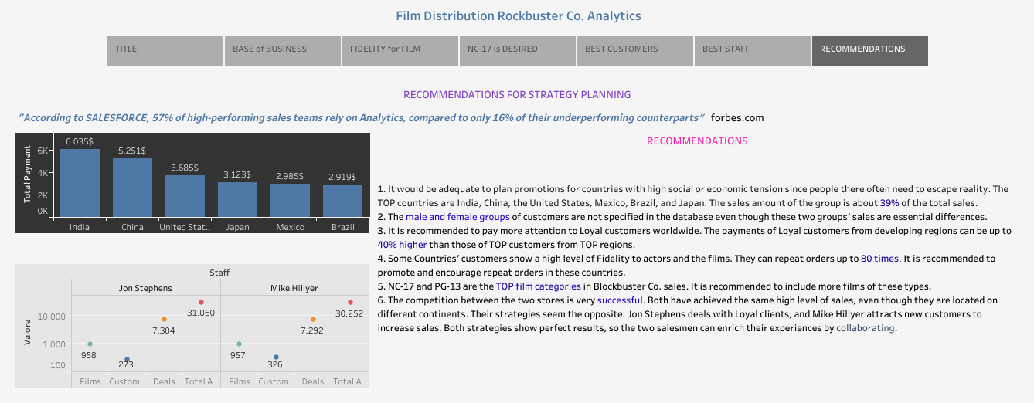

Slide 8

Thank you!

